Slide 1

ENT-603- Pitching the Idea
Team Name : Water Saving
199278039- Anagha Tupe
199278065- Santam Baul
199278021- Saurabh Tripathi
199278070- Vaibhav Gupta

Slide 2
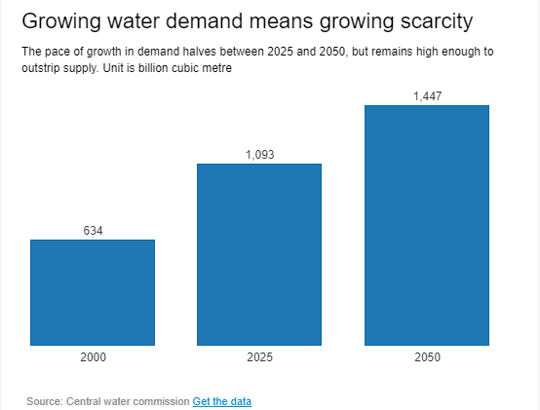
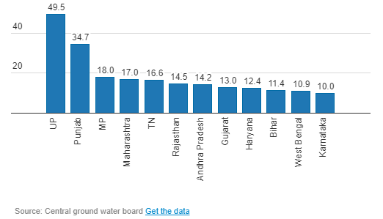


Problem and Need
Rapidly growing demand of water will eventually translate to water scarcity
Water Usage is much higher for UP and Punjab which uses ~35% of water in India
Problem
Need
Water scarcity in India is expected to worsen as the overall population is expected to increase to 1.6 billion by year 2050
21% of country’s diseases are water related
Children in 100 million homes in the country lack water
India is one 17 countries where "water stress" is "extremely high“
163 Million Indians don’t have access to clean drinking water
Conserve water and reduce water wastage and improve the quality of water

Slide 3
Solution
Water Conservation App
Create an App which will monitor water usage in a household
APP
Water Conservation
Data Analytics
Incentivizing Users
App will also have water usage data which can be used to help in water conservation
Analytics
Incentives
The App will provide incentives to users for reducing their water consumption or for meeting targets

Slide 4


Mission & Vision
Vision
Mission
“To reduce per capita water consumption by 10% by 2030”
“Improve awareness of water conservation among people by providing them transparent monitoring solution so that we can reduce its wastage at household level, and save the water for the needy once and future generation”

